Slide 1
How do we improve Airbnb operations?
Today’s Agenda:

Slide 2
Why did we conduct this case-study?
Economic, business, and socio-cultural frameworks within the lodging industry remain transient and dynamic, and Airbnb managers must remain updated towards consumer trends affecting pricing strategy
Sophisticated modeling of components driving consumer tastes allows both Airbnb corporate strategists and host managers to productively invest in productive features or divest irrelevant costs to optimize cost structures, and ultimately, increase net profits

Slide 3
Airbnb has accumulated data towards this mission:
Data sources:
These datasets stem from the Kaggle database (https://www.kaggle.com) as well as Wikipedia
Kaggle: is an online data science platform that hosts competitions and practice for data science practitioners. Although the types of data are typically limited via this source, the data itself gleaned are usually cleaned and ready for analysis.
Wikipedia: is an online free encyclopedia, with readily available tables that can easily convert to CSV for the data science process

Slide 4
Airbnb room features contained in the datasets:
- These are the main variables that organize our insights
Price
Room Type (Private/Shared/Entire Home/Apt)
Host is Superhost?
Multiple Rooms or Not?
Biz (Business Indicator)
Guest Satisfaction
Number of Bedrooms
Distance from City Center
Person Capacity
Cleanliness Rating
Attraction Index (proximity to valuable tourist attractions)
Restaurant Index (proximity to valuable restaurants)
GDP of City
GDP per capita of City
Population of City
Shared Room?
Weekday/Weekend Rental

Slide 5
Exploratory Data Analysis:
In this stage (EDA), we can create visualizations with the features and data points to spot easily discernable patterns
Overall: EDA actually became the most important stage for analysis due to limitations of the eventual ML model (ML models will be discussed after this stage).
Let’s begin the visualization process:

Slide 6
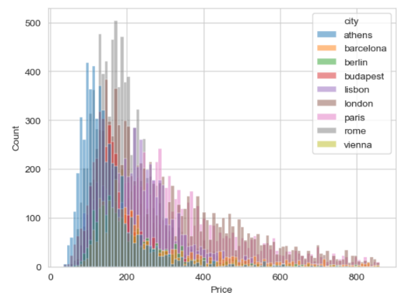
Price distribution for all cities
- As easily discerned between the X and Y axis, there is a heavy skew to the right, which means there is a heavy emphasis on the premium price segment

Slide 7
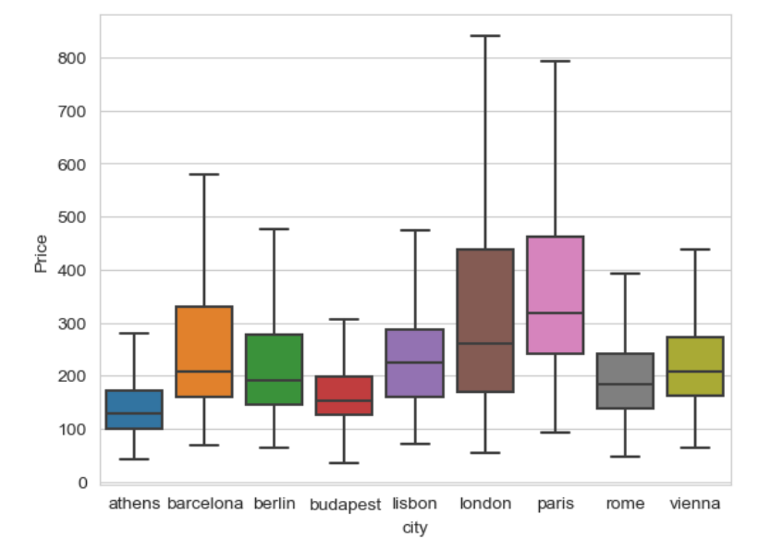
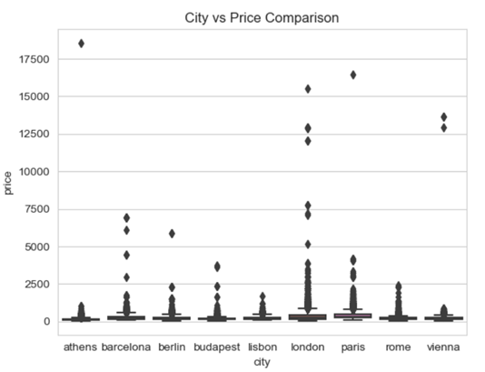
Each city’s price dispersion was plotted to understand the price dynamics of each city:
Two main patterns emerge:
Each city follows their own price dynamic
Again, there is heavy emphasis on the premium markets
The left chart includes all data points The right chart cuts out all the outliers based on IQR:

Slide 8
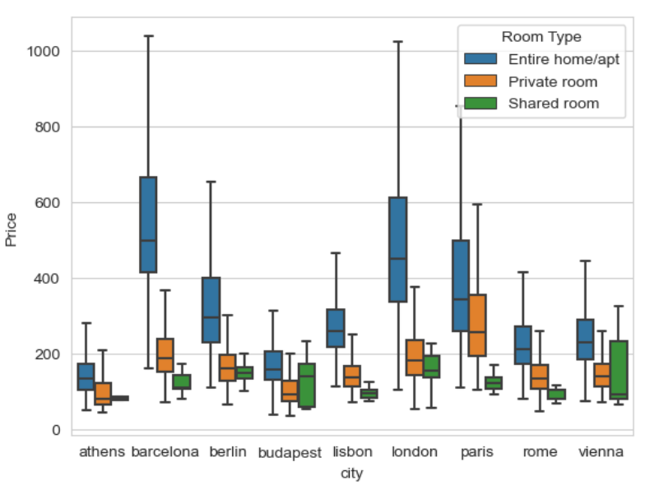
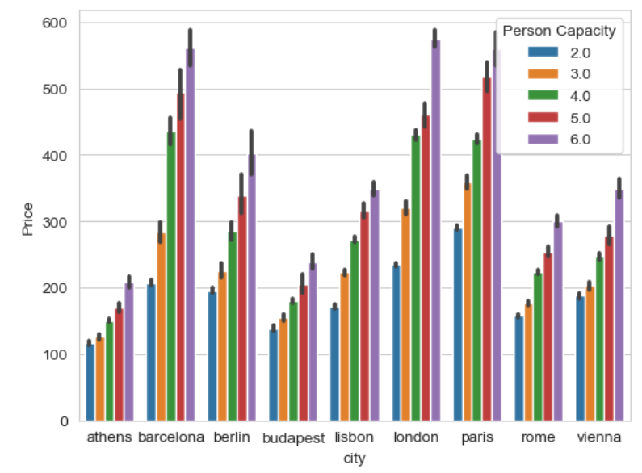
Below are plots of two features that correlate: Room Type and Person Capacity
As expected, you can easily observe the strong positive correlation between larger room / person capacity vs higher price
However, unexpectedly Barcelona possesses the largest mean home/apt price. Why? Keep this fact in mind as we investigate this anomaly in more depth (next slide)

Slide 9
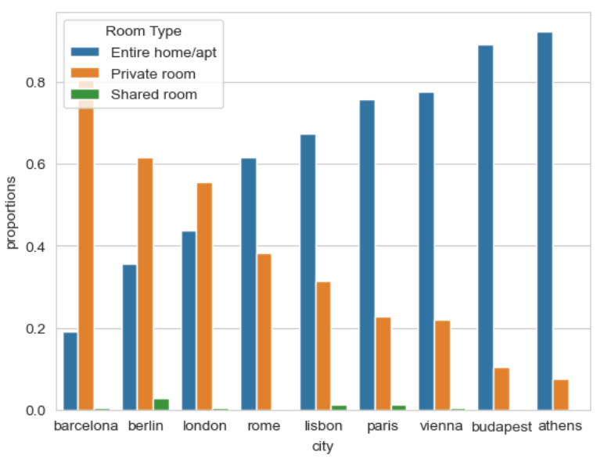
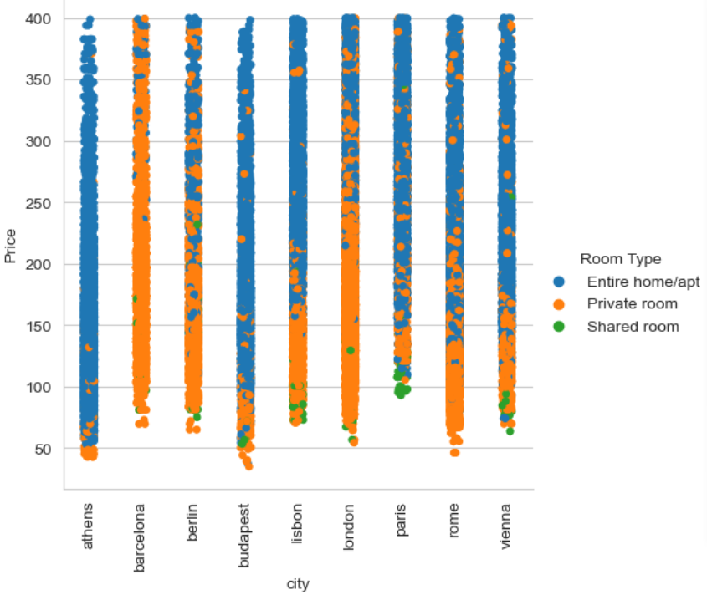
Simultaneously with highest prices, you can easily see Barcelona also exhibits the lowest percentage of units within this category ‘Entire home/apt’ and at each price point
Left plot: Proportion Right plot: Room (type) by Price

Slide 10
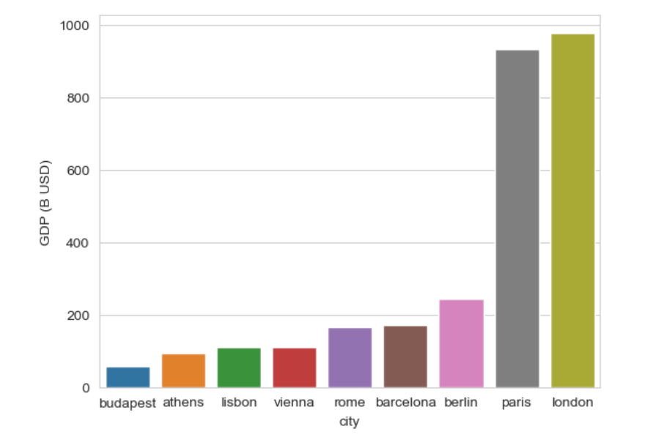
Does GDP Explain Barcelona’s outlier supply-demand characteristics?
While viewing these respective cities’ charts, you may have pondered if economic characteristics such as city GDP may predispose Barcelona (and other cities) towards outlier features.
- As you can see below, London and Paris are the economic outliers (by GDP), and actually, Barcelona is in the middle of the pack

Slide 11
Major EDA insight:
As discernable in the above graphs, Barcelona’s simultaneous balance of high price (high demand) vs low proportion of units in that Entire Room/Apt category (low supply) is unusual in comparison with other cities.
Furthermore, this low supply/high demand suggests a supply-demand imbalance, and is a peculiarity that Airbnb should investigate heavily into, for perhaps it suggests Airbnb can house a plethora of more ‘Entire rooms/Apts’ in Barcelona.
Basically, supply vs demand has not reached an efficient market equilibrium yet, which means there is much more room for profit

Slide 12
EDA insight part 2:
However , we can’t conclude conclusively yet that it is a lack of supply that directs this imbalance. There is a plethora of other variables that may stymie ‘Entire Room/Apt’ category – i.e. housing/zoning restrictions, types of attractions that attract only ultra-wealthy clients etc.
Having said this, Airbnb should invest more resources into investigating this peculiar imbalance in Barcelona

Slide 13
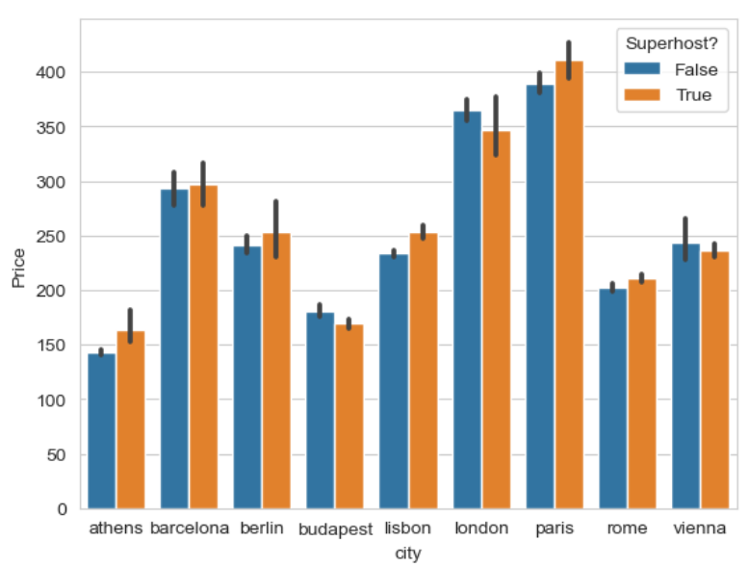
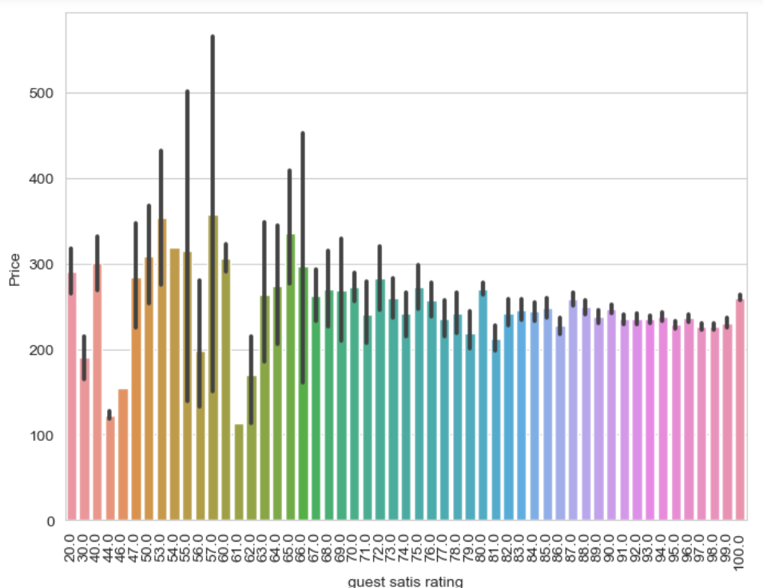
Other EDA insights:
Surprisingly, Superhost(?) or guest satisfaction are surprisingly not valuable features towards Airbnb pricing.
These insights can help Airbnb hosts invest their resources more effectively

Slide 14
Machine Learning Modeling:
Five different Machine Learning Regressors – Linear Regression, Lasso, Random Forest, Gradient Boost, KNN Regressor - were fitted onto the dataset to formulate a predictive model and determine feature importance based on the features contained within the dataset

Slide 15
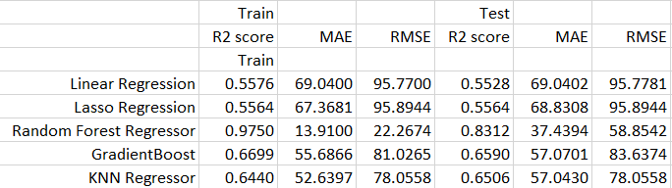
Below are the performance metrics for each regressor:
Random Forest is the clear performance winner

Slide 16
According to Random Forest, these are the most important features, in order of importance:
1. Attr - Index (room proximity to attractions)
2. Private rooms are significantly valued
3. Rest-Index (proximity to valuable restaurants)
4. Person Capacity - # of people per unit, which correlates with Room Type (entire room/apt vs private room)
5. Dist (distance from city center), which correlates with distance from attractions
6. Bedrooms
7. Distance from Metro
8. Guest - Satisfaction

Slide 17
Cautionary Context: The limits to this machine Learning model and dataset
Limited macroeconomic variables for robust analysis of overall supply-demand characteristics:
Limited microeconomic / room features for robust analysis of Airbnb rooms competitive advantage
Limited business dimensions to assess business operations:
Lack of clarity of socio-cultural dimensions within consumer psychology for each respective city:
Basically: There are not enough features in the dataset to account for the entire ecosystem of variables that determine Airbnb price. We should collect more robust information to conduct a more rigorous analysis

Slide 18
Overall Analysis of the Machine Learning Model:
The dataset features and consequent machine learning model is reductionist in its interpretation of the overall socio-economic and cultural ecosystem that influence Airbnb pricing
Thus, the ML model may become misleading in its predictions. Although this study produced some valuable insights, more rigorous studies are recommended.

Slide 19
Future Recommendations – Future Studies
Separate linear regressions should be conducted for each individual city:
Furthermore, for each additional city, separate linear regressions should be computed for each price segment - i.e. bargain, economic, luxury, ultra-luxury etc.
Implement more methods to collect and increase variety of features in dataset:

Slide 20
Airbnb operations-specific recommendations:
Insert Random Forest’s feature importance list as a section within Airbnb host’s platform: Although the ML models are reductionist, they still do possess interesting discoveries. For instance, Airbnb can benefit from knowing what features are more important than others.
Deploy more resources to investigate the supply-demand imbalance in Barcelona: As discussed in the EDA stage
Similarly, investigate the premium category for all cities with low proportion of ‘Entire Room/Apt’: The ‘Entire Room/Apt’ category in is the main cash cow for Airbnb. Thus, Airbnb should deploy more resources into investigating why the cities with such low proportion of this category exhibit this characteristic.

